Slide 2
learn concepts of machine learning.
learn four categories of machine learning.

Slide 3
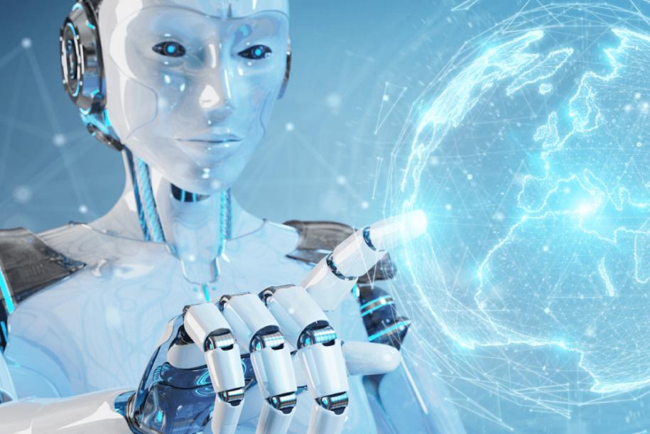
Artificial Intelligence

Slide 4






Introduction
Learn
Predict

Slide 5
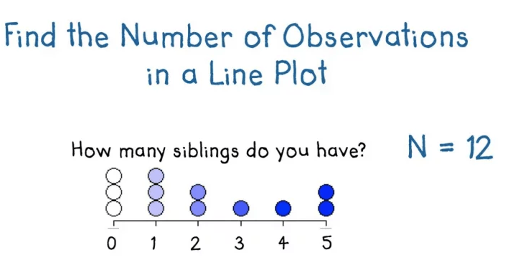
Introduction
Starts with observations or data

Slide 6
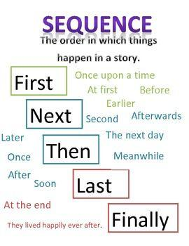
Introduction

Slide 7
Machine Learning Methods
Machine learning approaches are traditionally divided into four broad categories:
Supervised learning
Unsupervised learning
Semi-supervised Learning
Reinforcement learning:

Slide 8
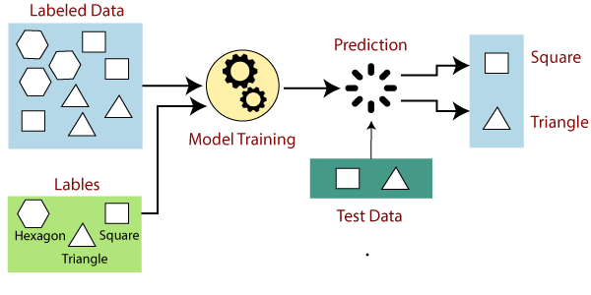
Supervised machine learning algorithms

Slide 9
Supervised learning algorithms
Various algorithms and computation techniques are used in supervised machine learning processes
Neural networks
Naive Bayes
Linear regression
Logistic regression
Support vector machine (SVM)
K-nearest neighbor
Random forest

Slide 10
Supervised learning examples
A variety of commercial applications, including the following, may be built and advanced using supervised learning models:
Image- and object-recognition
Predictive analytics
Customer sentiment analysis
Spam detection

Slide 11
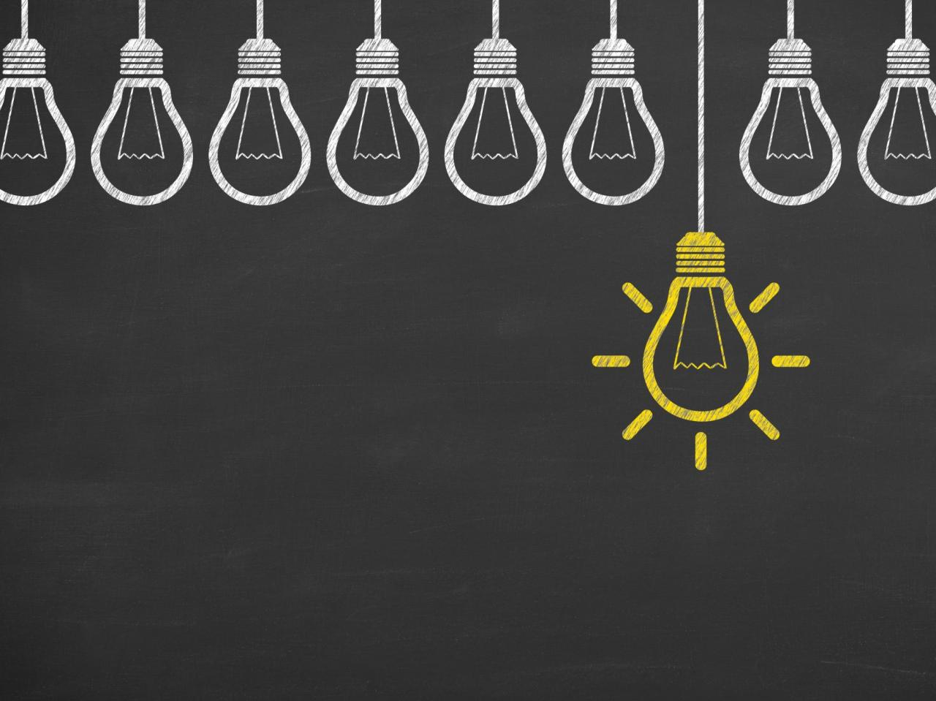
Challenges of supervised learning

Slide 12
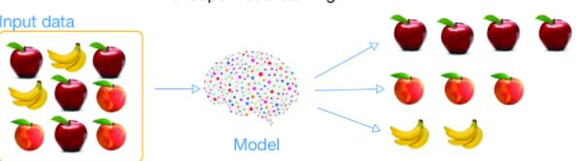
Unsupervised machine learning algorithms

Slide 13
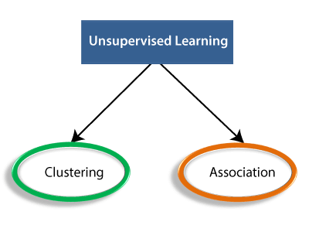
Types of Unsupervised Learning Algorithm

Slide 14
Unsupervised Learning algorithms
list of some popular unsupervised learning algorithms are:
  K-means clustering
  KNN (k-nearest neighbors)
  Hierarchal clustering
  Anomaly detection
  Neural Networks
  Principle Component Analysis
  Independent Component Analysis
  Apriori algorithm
  Singular value decomposition

Slide 15
Advantages of Unsupervised Learning
Unsupervised learning is used for more complex tasks.
Unsupervised learning is preferable.

Slide 16
Disadvantages of Unsupervised Learning
Because it lacks a comparable output.
Because the input data is not labelled and algorithms do not know the precise output in advance.

Slide 17
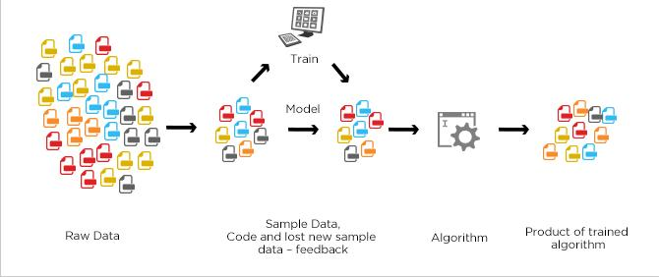
Semisupervised machine learning algorithms

Slide 18
Semisupervised machine learning algorithms
A Semi-Supervised algorithm assumes the three factors about the data
Continuity Assumption
Cluster Assumption
Manifold Assumption

Slide 19
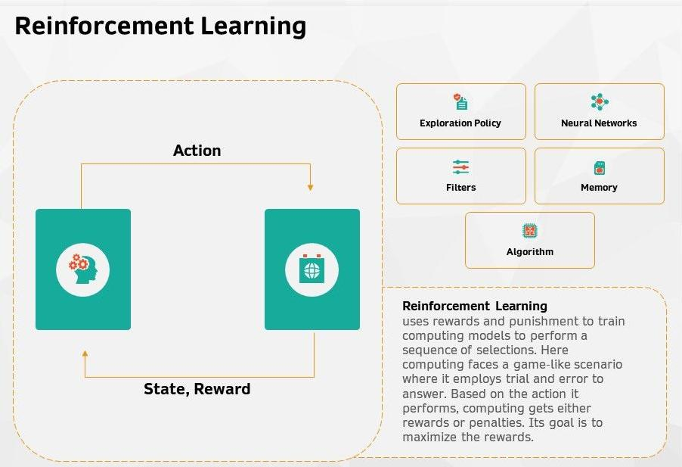
Reinforcement machine learning algorithms

Slide 20
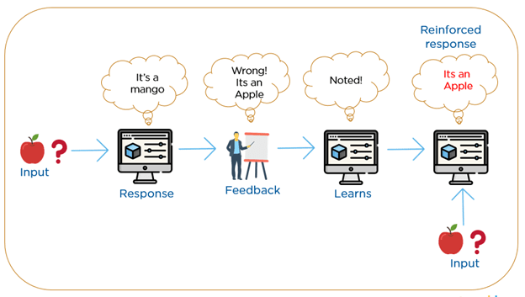
Reinforcement machine learning algorithms

Slide 21
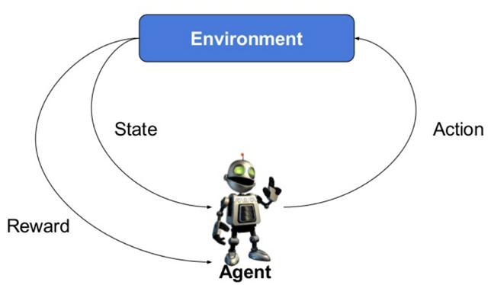

Slide 22
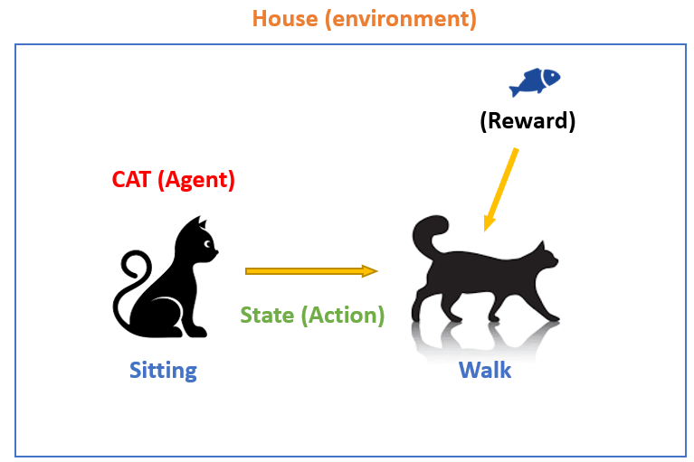
How reinforcement learning works?

Slide 23
Reinforcement Learning Algorithms
There are three approaches to implement a Reinforcement Learning algorithm.
Value-Based
Policy-based
Model-Based
n{a/s) = P\A, = a\S, =S]

Slide 24
Characteristics of Reinforcement Learning
There is no supervisor.
Decisions in a sequential order
Time is critical.
Feedback is never immediate.
The data determined by its activities.

Slide 25
Types of Reinforcement Learning
Two kinds of reinforcement learning methods are:
Positive
Negative

Slide 26
Learning Models of Reinforcement
There are two important learning models in reinforcement learning:
Markov Decision Process
Q learning

Slide 27
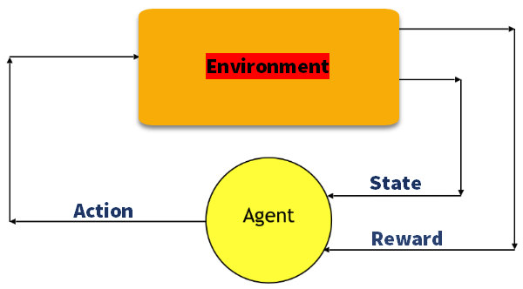
Markov Decision Process

Slide 28
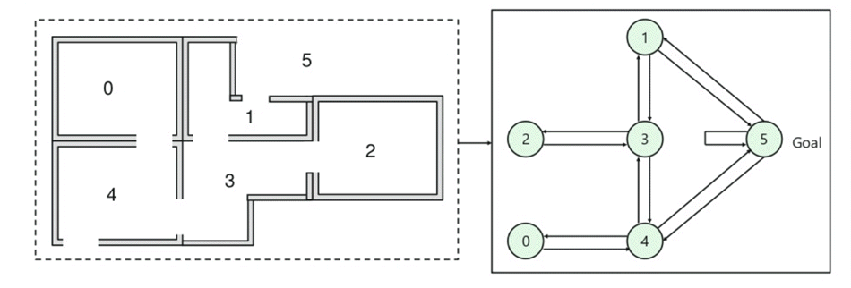
Q-Learning

Slide 29
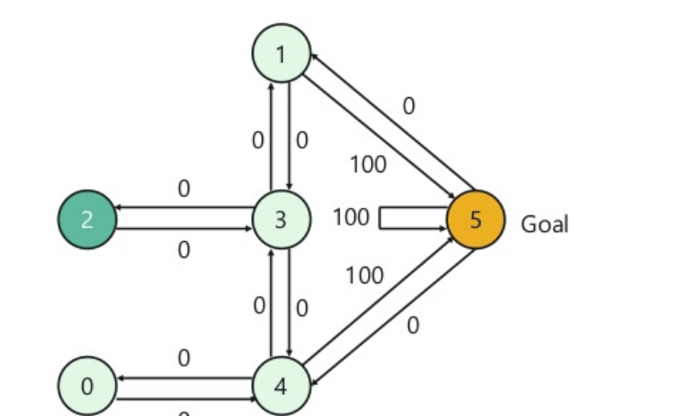
Q-Learning

Slide 30
Reinforcement Learning vs. Supervised Learning
Parameters | Reinforcement Learning | Supervised Learning
Decision style | Reinforcement learning enables you to make judgments in a sequential manner. | The input supplied at the start is used to make a choice in this procedure.
Works on | Interacting with the surroundings is a priority. | Works with examples or data provided as a sample.
Dependency on decision | The learning choice in the RL technique is dependent. As a result, all of the dependent decisions should be labelled. | Supervised learning of judgments that are unrelated to one another, with labels assigned to each decision.
Best suited | Supports and works better in AI if there is a lot of human contact. | It is typically controlled by a software system or apps that are interactive.
Example | Chess game | Object recognition

Slide 31
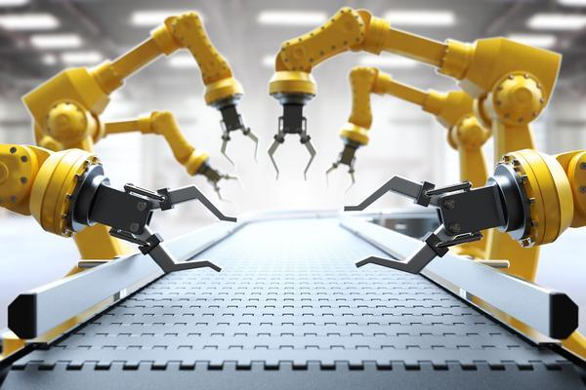
Applications of Reinforcement Learning
Robotics for industrial automation.

Slide 32
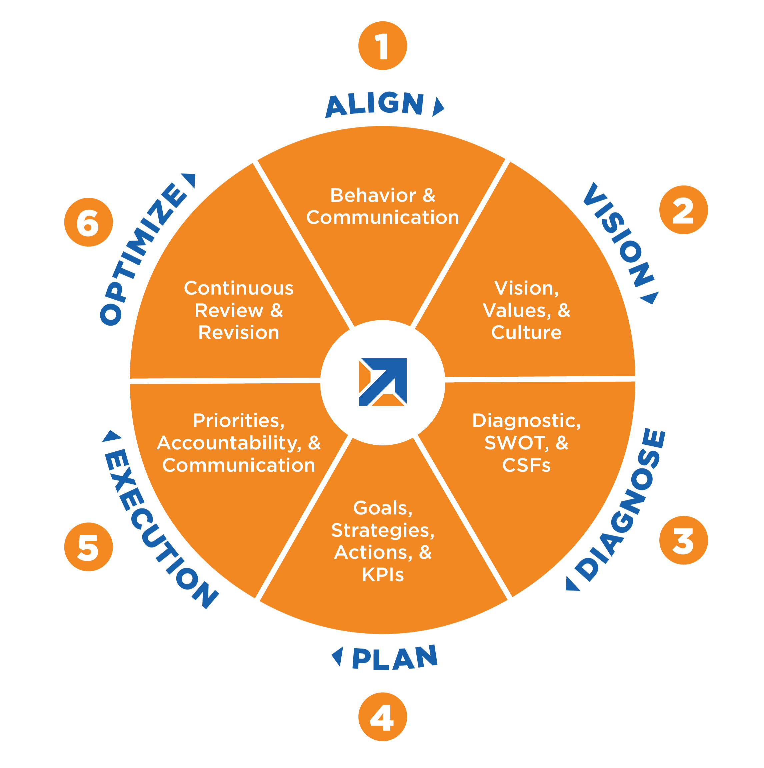
Applications of Reinforcement Learning
Business Strategy planning

Slide 33
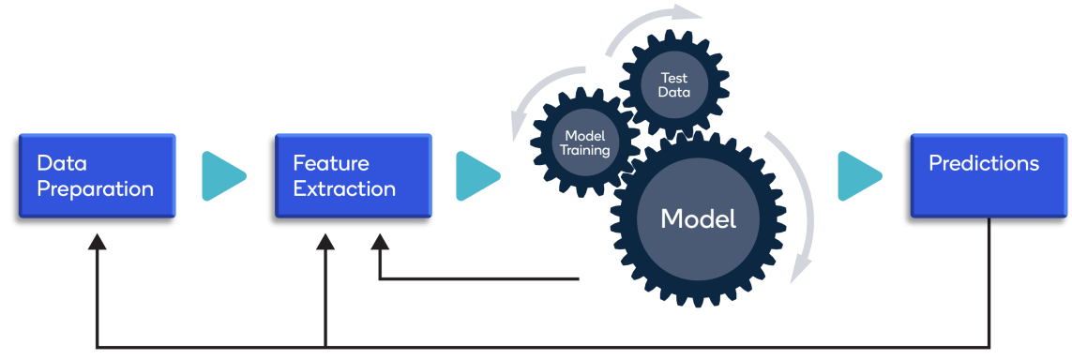
Applications of Reinforcement Learning
Machine Learning and Data Processing

Slide 34
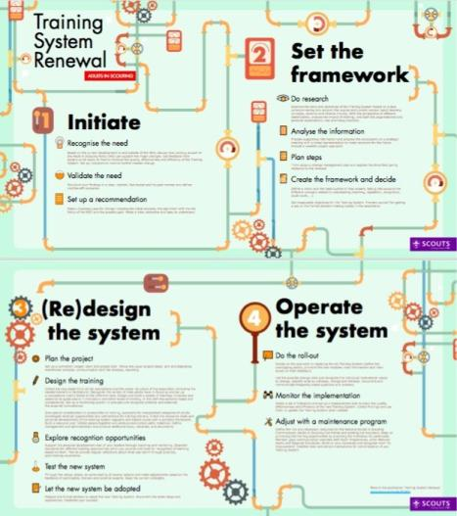
Applications of Reinforcement Learning
create training systems that provide custom instruction

Slide 35
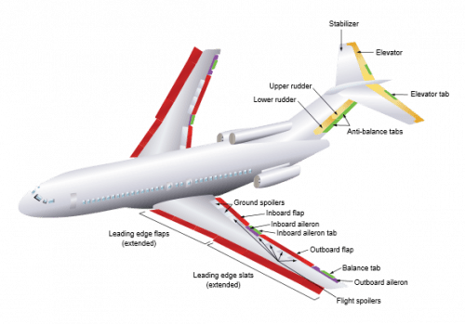
Applications of Reinforcement Learning
Aircraft control and robot motion control

